Slide 1

Artificial Intelligence Lecture 6

Slide 2
Decision Trees and random Forest
Notes:
Some of the slides are credited to Andreas C. Müller

Slide 3
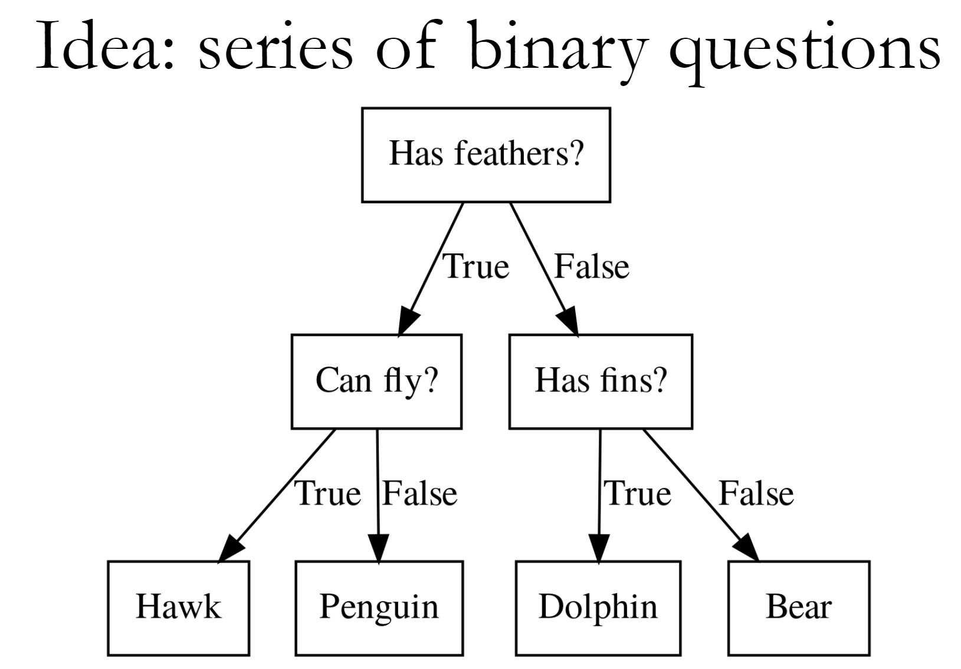

Slide 4
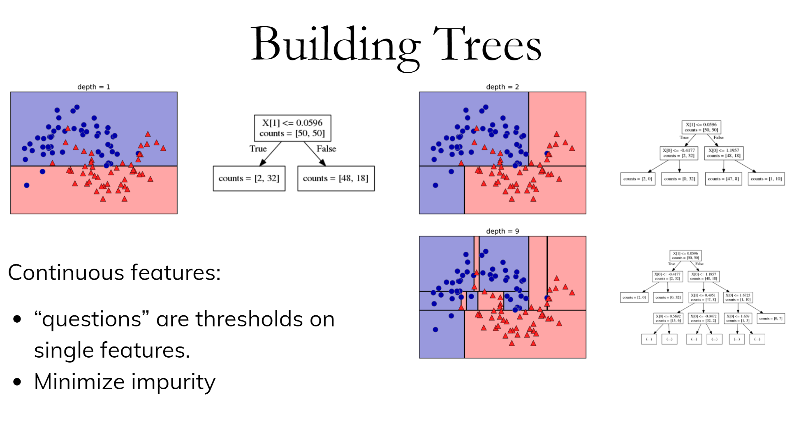

Slide 5
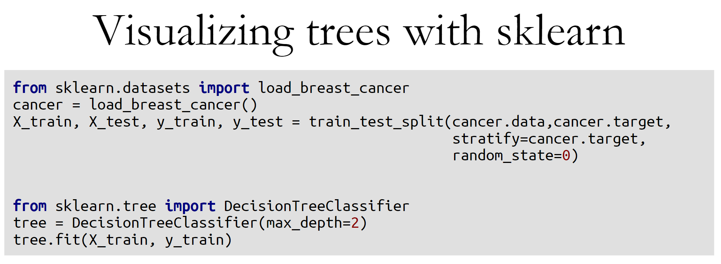

Slide 6
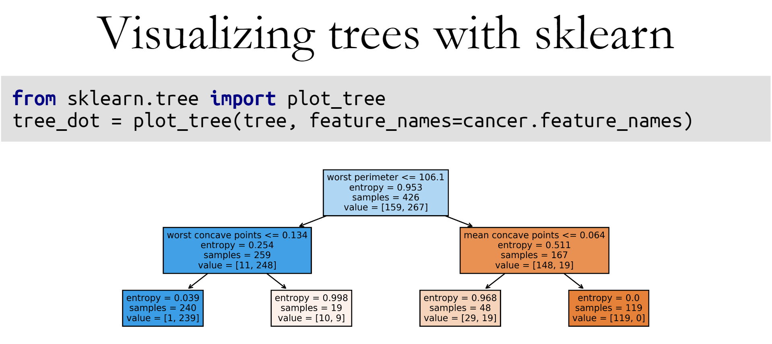

Slide 7
Gini impurity
Chest pain | Good blood circulation | Blocked arteries | Heart disease
No | No | No | No
Yes | Yes | Yes | Yes
Yes | Yes | No | No
Yes | No | No | Yes
… | … | … | …
???

Slide 8
Gini impurity
Chest pain
True
False
Heart disease
Yes:105
No:39
Heart disease
Yes: 34
No: 125

Slide 9
Gini impurity
Good blood circulation
True
False
Heart disease
Yes:37
No:127
Heart disease
Yes: 100
No: 33

Slide 10
Gini impurity
Blocked arteries
True
False
Heart disease
Yes:92
No:31
Heart disease
Yes: 45
No: 129
The goal is selecting the root node

Slide 11
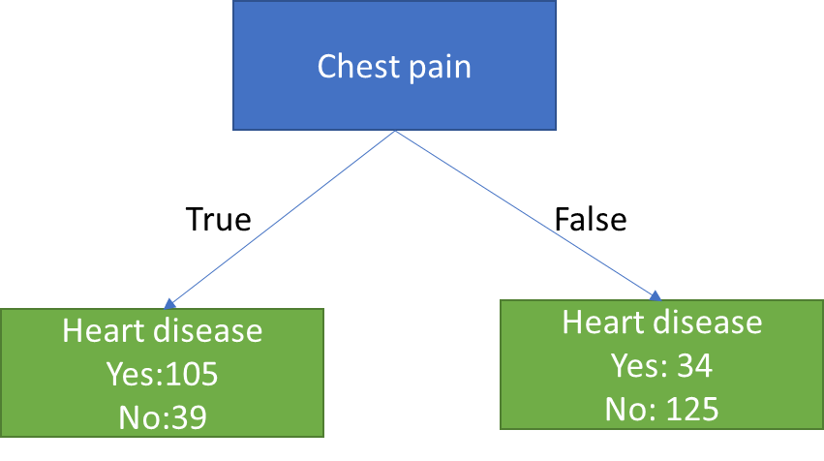
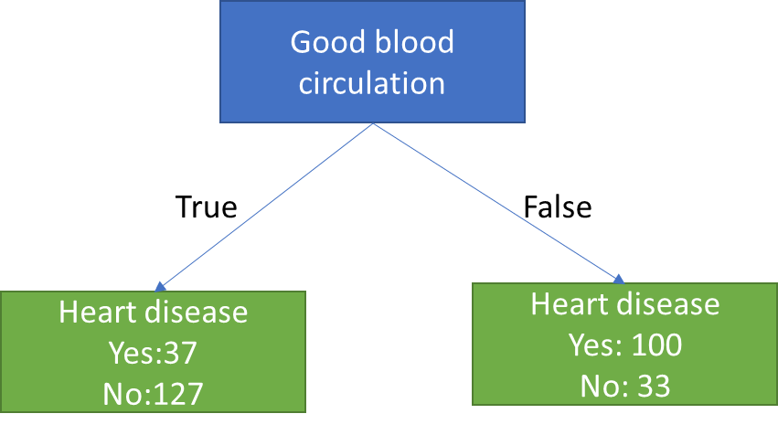
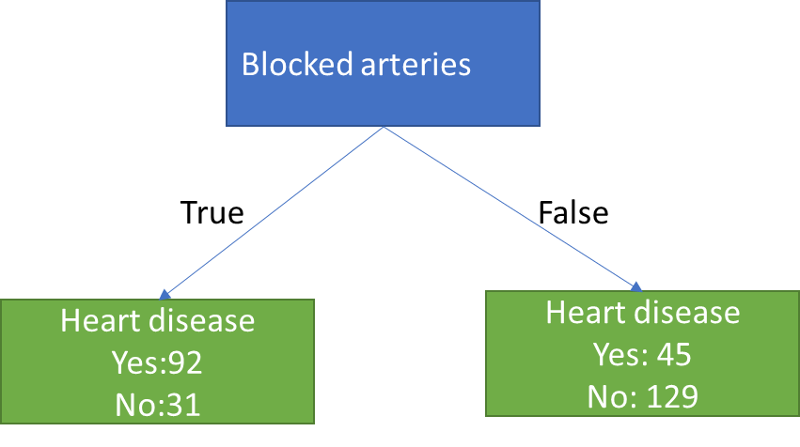
Gini impurity
None of these are providing good classification results
Sine none of the leaf nodes are 100% “Yes Heart Disease” or 100% “No Heart Disease”, they are all considered impure.
To decide which separation is best we need to calculate “impurity”. We will use GINI

Slide 12
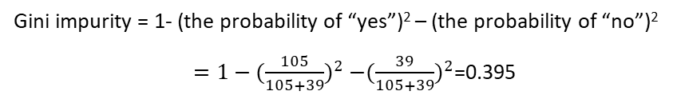
Gini impurity
Chest pain
True
False
Heart disease
Yes:105
No:39
Heart disease
Yes: 34
No: 125
Gini impurity = 0.395
Gini impurity = 0.336
Gini impurity = 1- (the probability of “yes”)² – (the probability of “no”)²
$=1−{(\frac{105}{105+39})}^{2}$ $−{(\frac{39}{105+39})}^{2}$=0.395

Slide 13
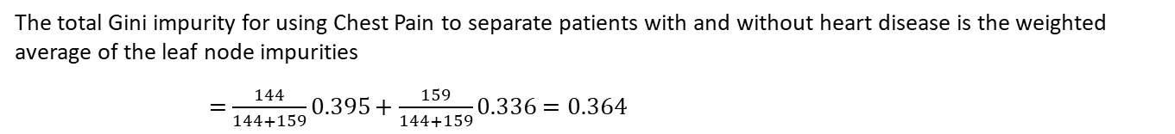
Gini impurity
Chest pain
True
False
Heart disease
Yes:105
No:39
Heart disease
Yes: 34
No: 125
Gini impurity = 0.395
Gini impurity = 0.336
The total Gini impurity for using Chest Pain to separate patients with and without heart disease is the weighted average of the leaf node impurities
$=$ $\frac{144}{144+159}0.395+\frac{159}{144+159}0.336=0.364$

Slide 14
Gini impurity
Gini impurity for chest pain = 0.364
Gini impurity for good blood circulation= 0.360
Gini impurity for blocked arteries= 0.381

Slide 15
Gini impurity
Gini impurity for chest pain = 0.364
Gini impurity for good blood circulation= 0.360
The lowest Gini impurity separates the patients with/without disease the best)
Gini impurity for blocked arteries= 0.381

Slide 16
Gini impurity
Good blood circulation is used as a root of the tree
Chest pain | Good blood circulation | Blocked arteries | Heart disease
No | No | No | No
Yes | Yes | Yes | Yes
Yes | Yes | No | No
Yes | No | No | Yes
… | … | … | …
Good blood circulation

Slide 17
Gini impurity
Good blood circulation
37/127
100/33
Now, we need to look for the best features to use for splitting at these nodes

Slide 18
Gini impurity
Chest pain
Good blood circulation
True
False
Heart disease
Yes:13
No:98
Heart disease
Yes: 24
No: 29
37/127
100/33
Gini impurity for chest pain = 0.3
Blocked arteries
True
False
Heart disease
Yes:24
No:25
Heart disease
Yes: 13
No: 102
Gini impurity for blocked arteries= 0.290

Slide 19
Gini impurity
Chest pain
Good blood circulation
True
False
Heart disease
Yes:17
No:3
Heart disease
Yes: 7
No: 22
Blocked
100/33
24/25
13/102

Slide 20
Gini impurity
Chest pain
Good blood circulation
True
False
Heart disease
Yes:7
No:26
Heart disease
Yes: 6
No: 79
Blocked
100/33
Chest pain
13/102
Do these new node separate patients better than what we had before?
17/3
7/22

Slide 21
Gini impurity
Chest pain
Good blood circulation
True
False
Heart disease
Yes:7
No:26
Heart disease
Yes: 6
No: 79
Blocked
100/33
Chest pain
13/102
Do these new node separate patients better than what we had before?
17/3
7/22
Gini = 0.29
Gini = 0.2

Slide 22
Gini impurity
Good blood circulation
Blocked
Chest pain
Chest pain
13/102
92/3
Blocked
17/3
7/22
8/0
0/30

Slide 23
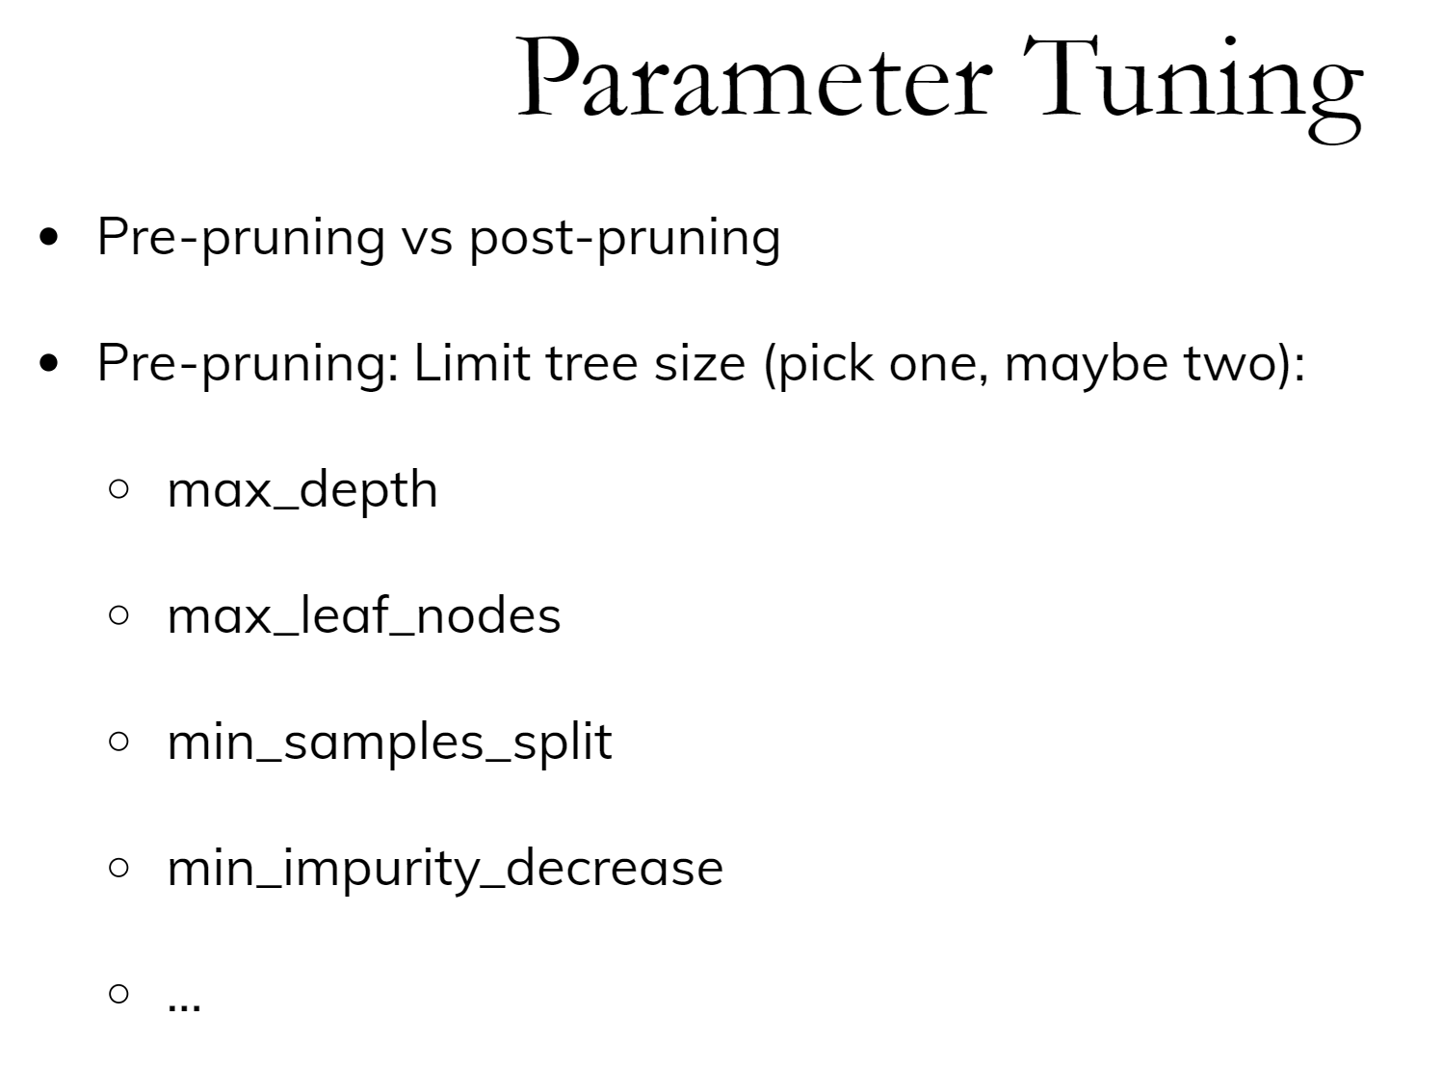
Notes:
Most of the tree growing algorithms
are greedy. There are two ways to restrict the growth of
the tree after you train them. There are pre-pruning and
post-pruning.
In pre-pruning, you restrict while you're growing. In
post-pruning, you build the whole tree (greedily) and then
you possibly merge notes. So you possibly undo sort of bad
decisions that you made, but you don't restructure the tree.
In scikit-learn right now, there's only pre-pruning. The
most commonly used criteria are the maximum depth of the
tree, the maximum number of leaf nodes, the minimum samples
in a node split and minimum decrease impurity.

Slide 24
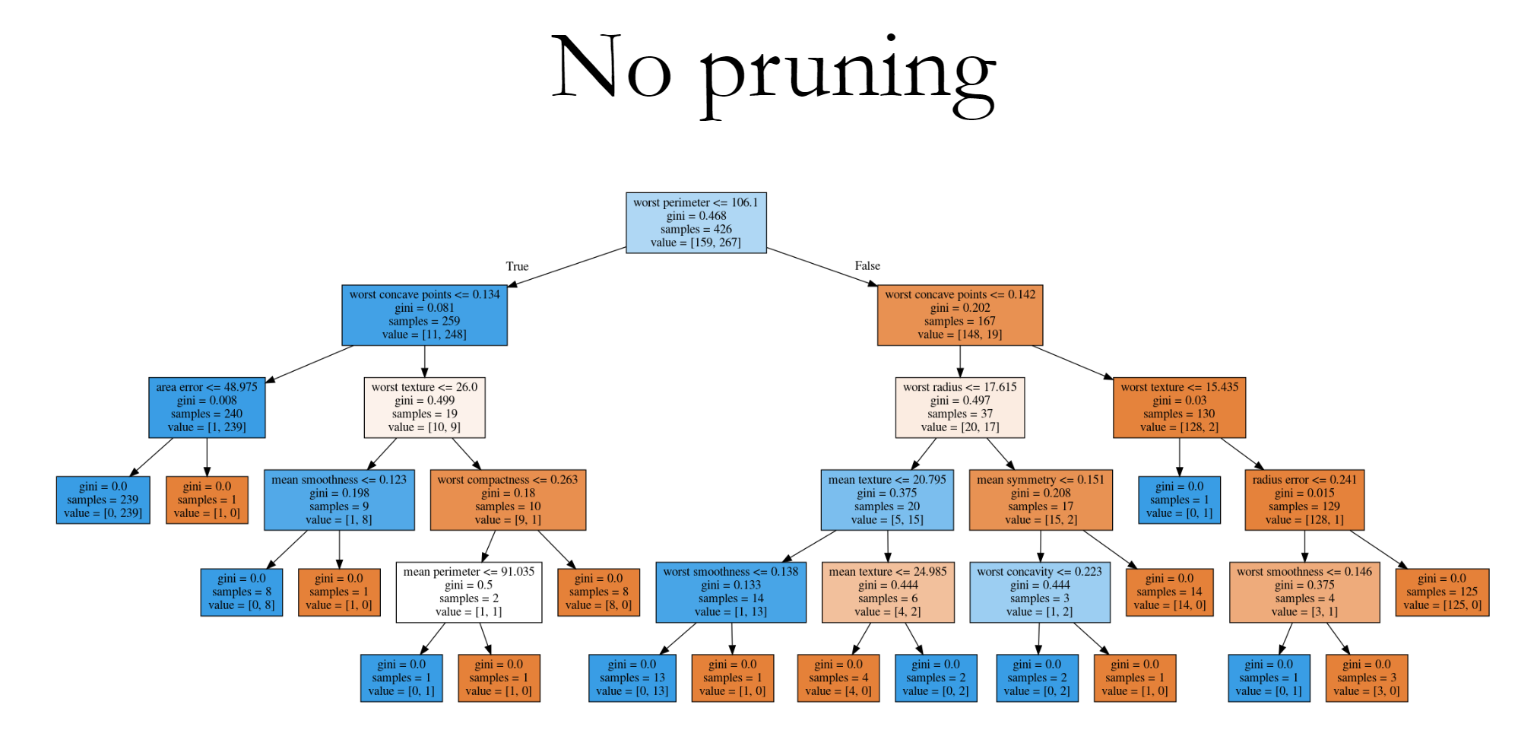

Slide 25
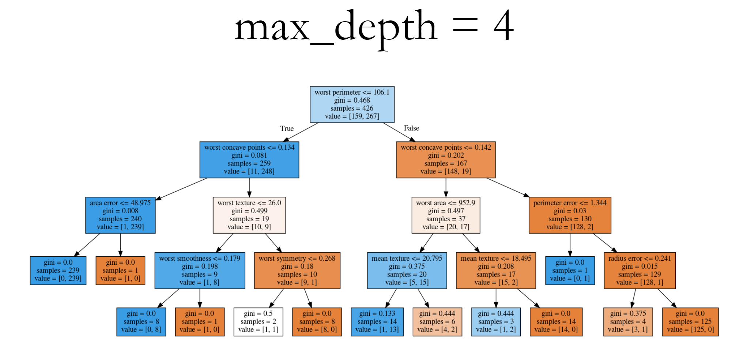

Slide 26
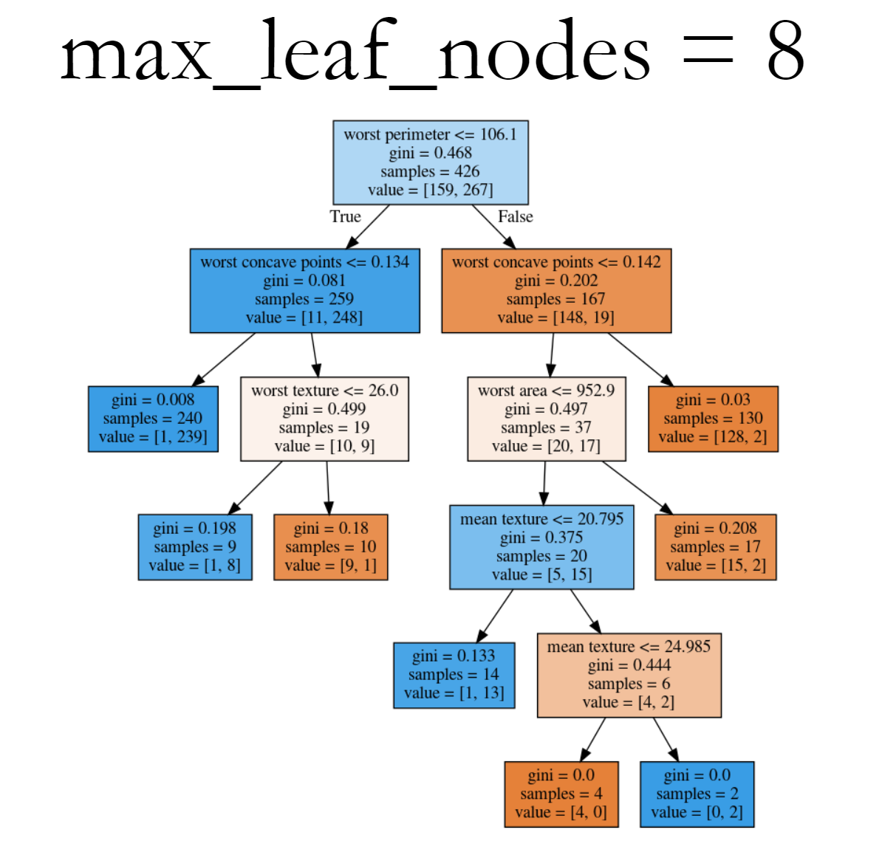

Slide 27
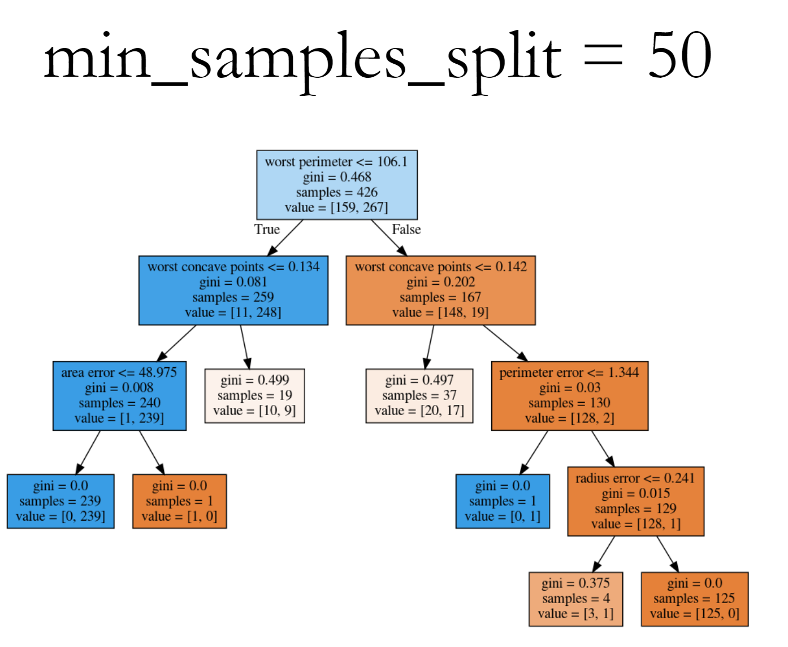

Slide 28
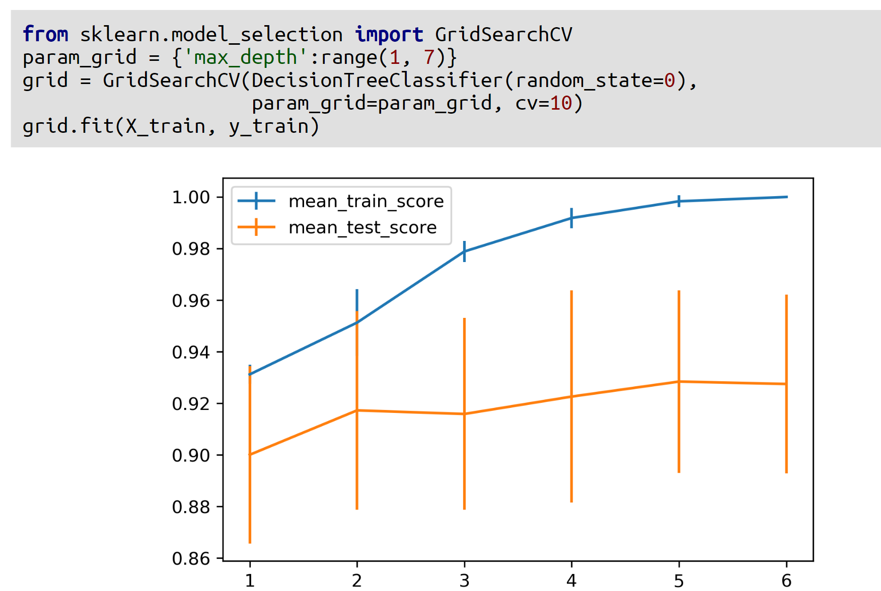

Slide 29
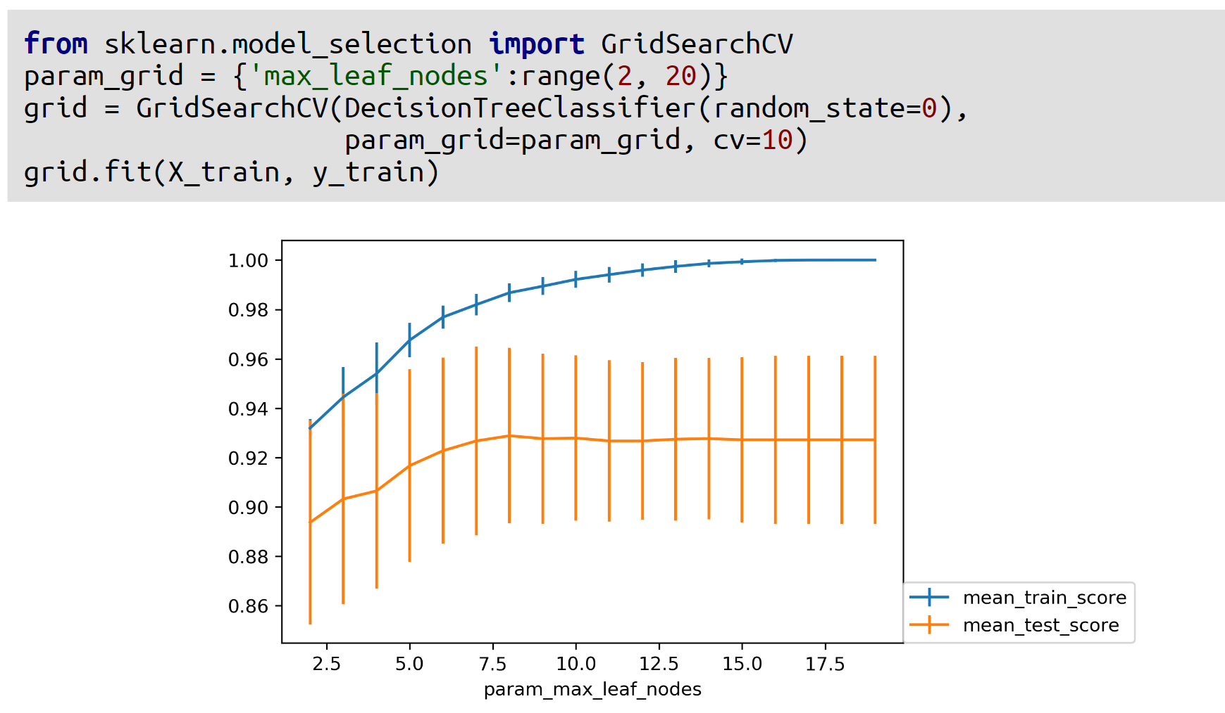

Slide 30
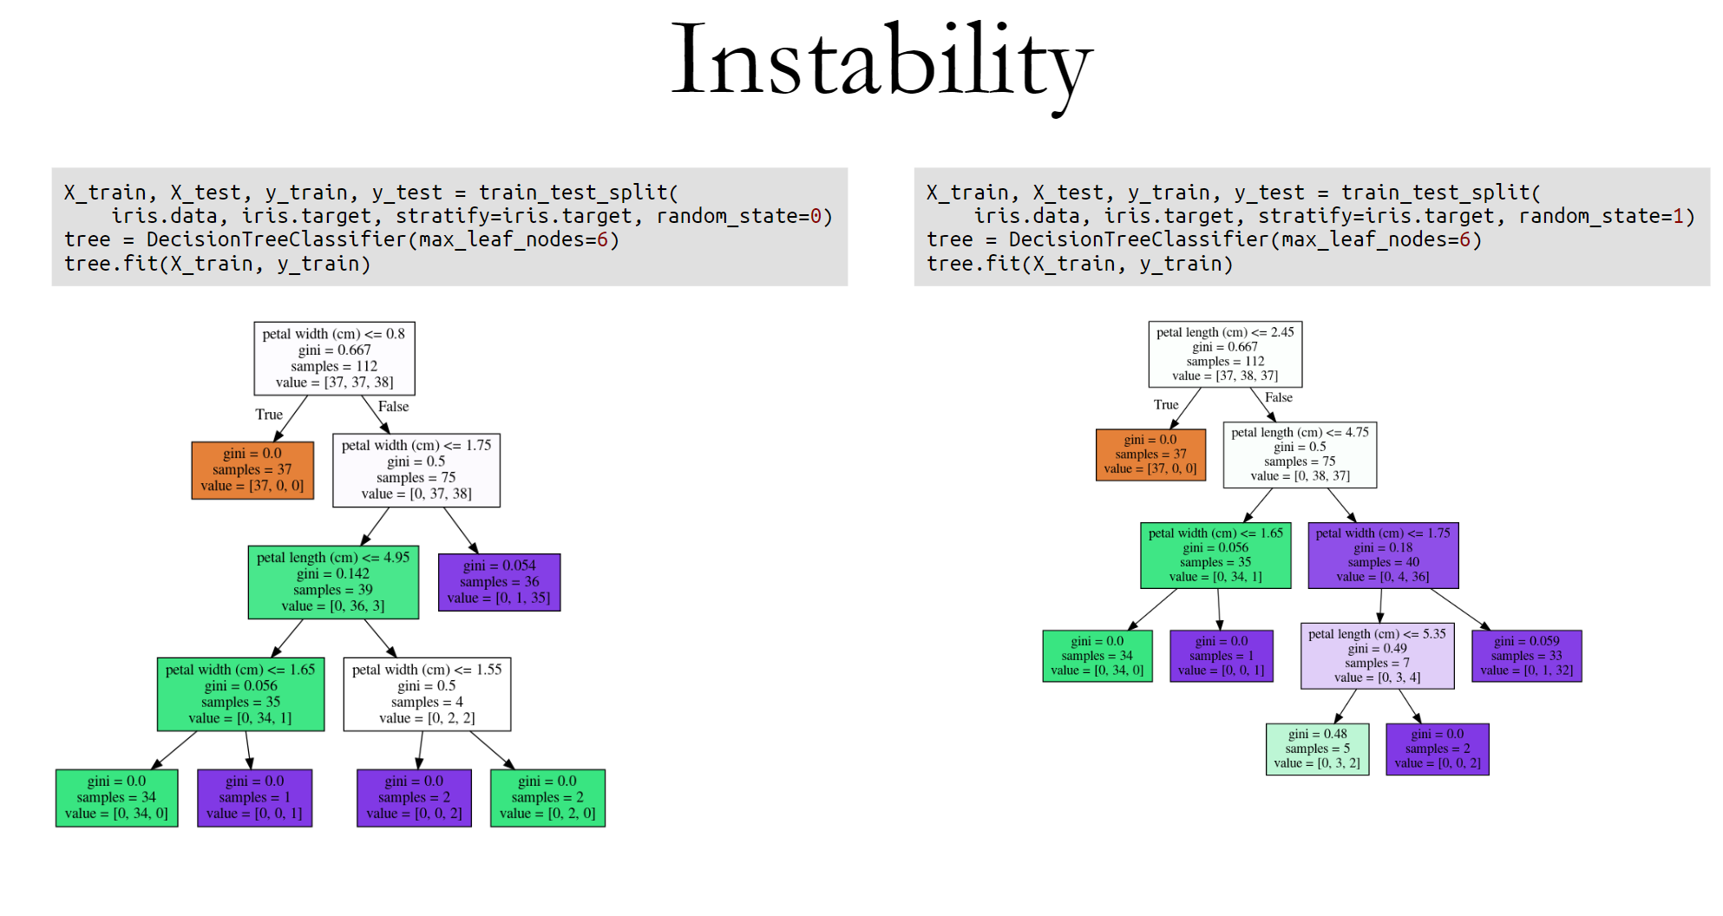

Slide 31
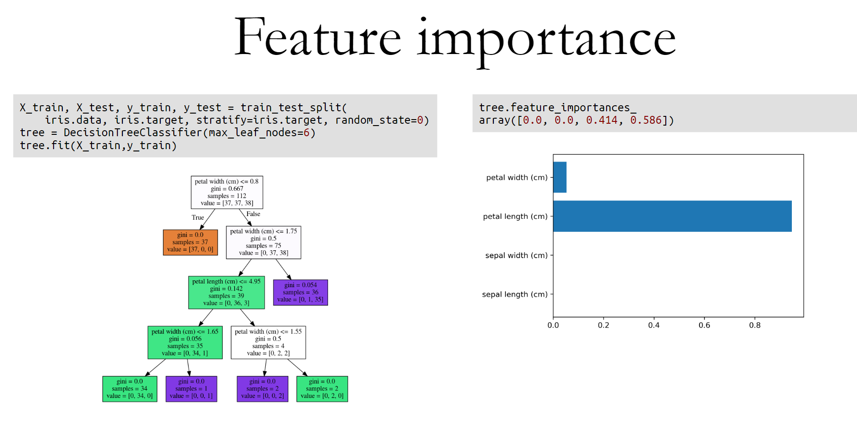
This is similar to the coefficients in the linear model, where you can see that “this feature influences the model in this way”. And the way this is done is basically each time a particular feature was chosen in a tree, you accumulate how much it decreased the impurity. It'll give more importance to features that were used often and where to use of it, than decreased impurity.
Problem with the importance is you have the same issues with instability. Because the tree structures unstable, the features picked is unstable and so the importance will be unstable.
One more comment about feature importance is that they give you the importance of a feature, but not the direction.

Slide 32
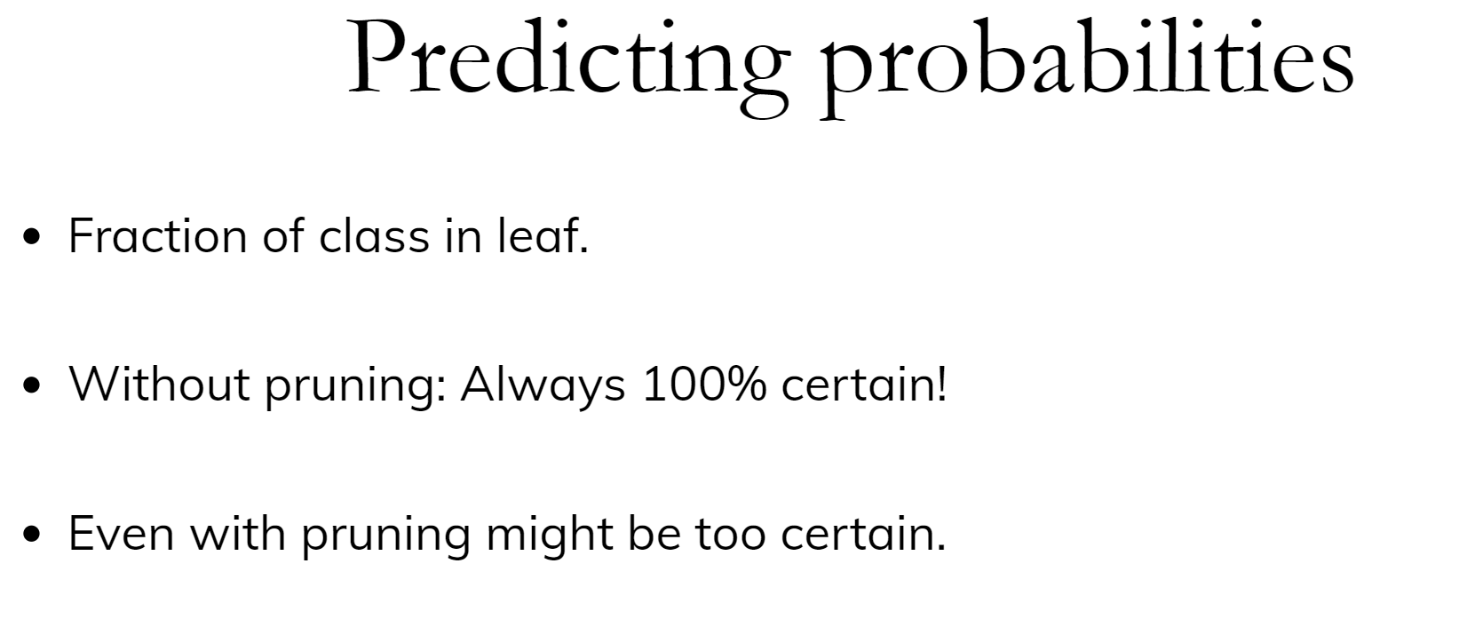

Slide 33
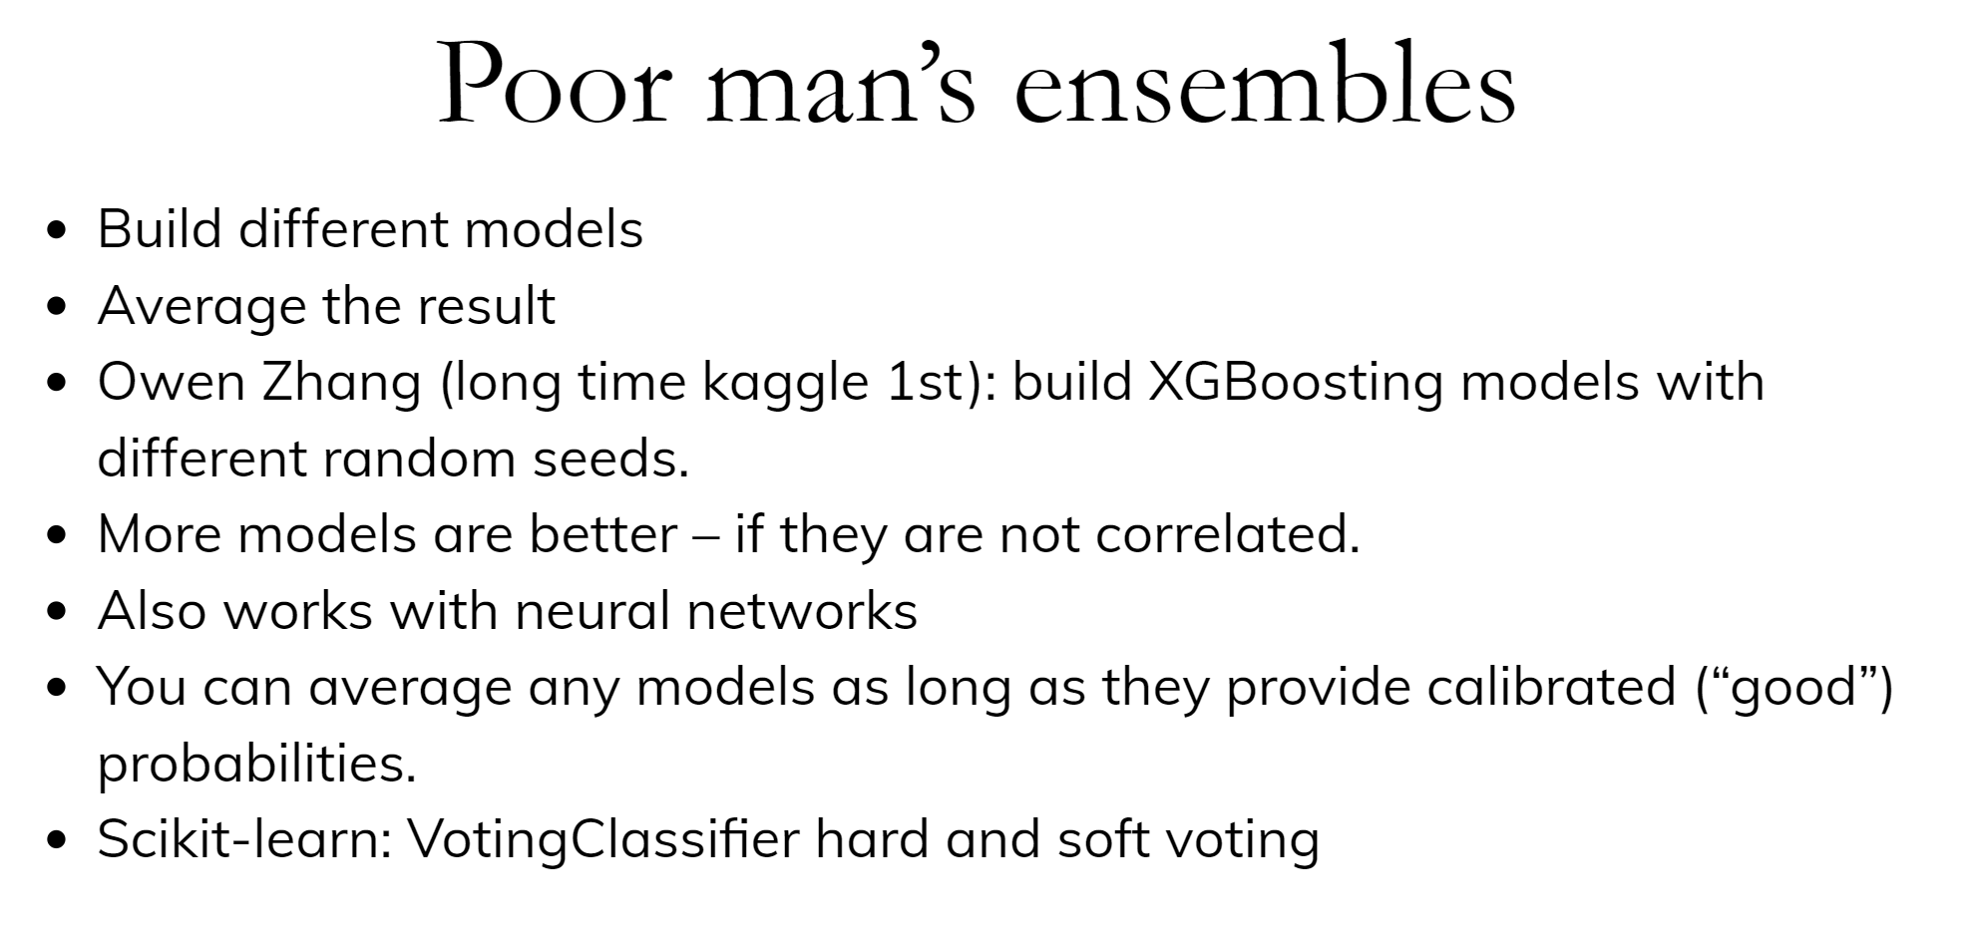

Slide 34
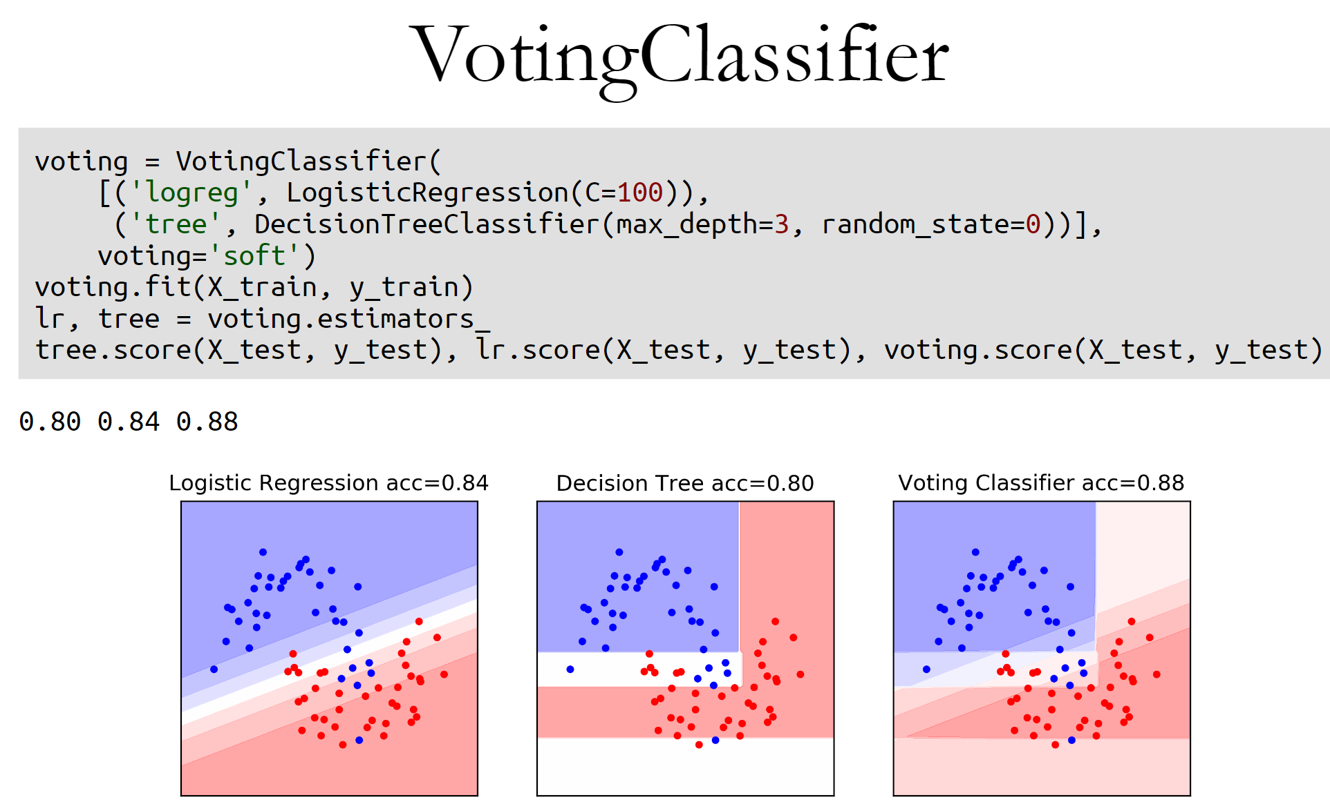

Slide 35
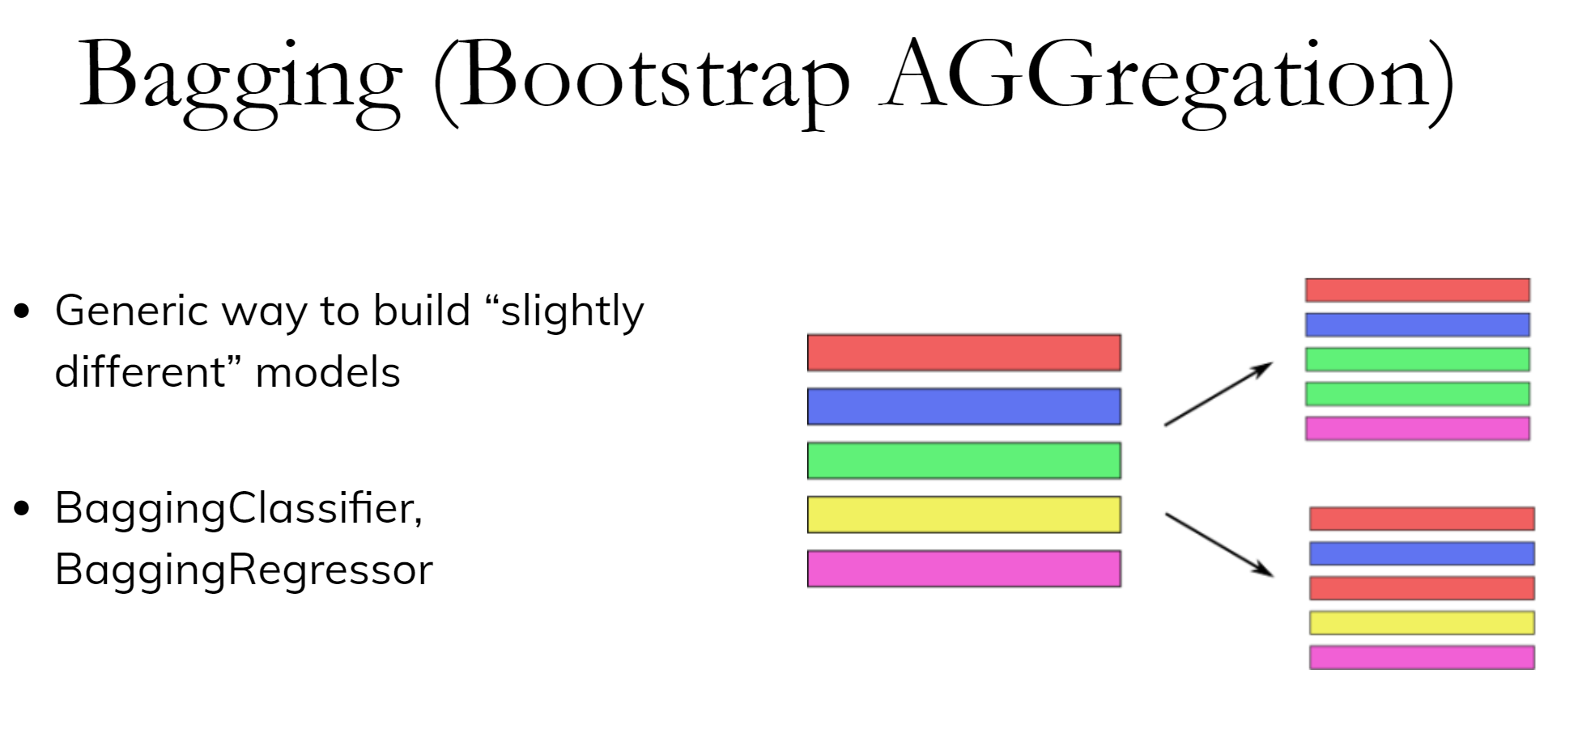

Slide 36
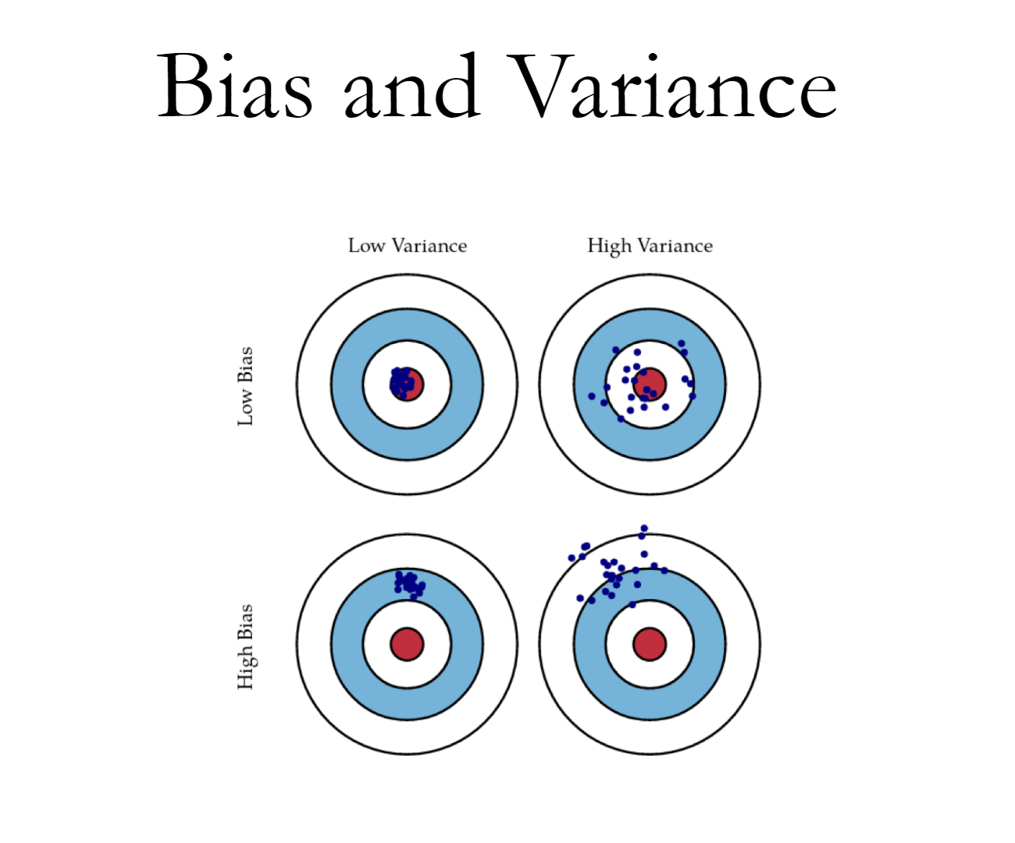

Slide 37
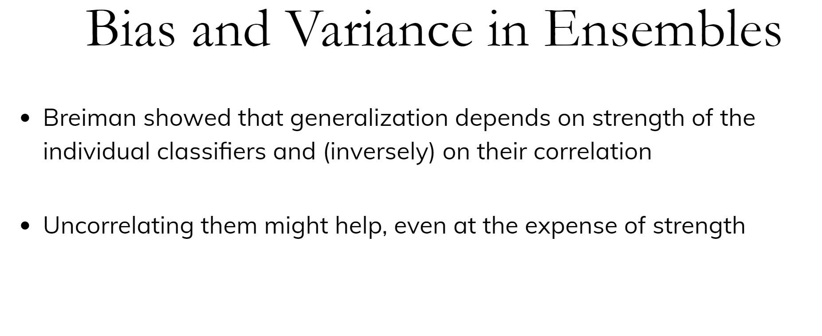

Slide 38
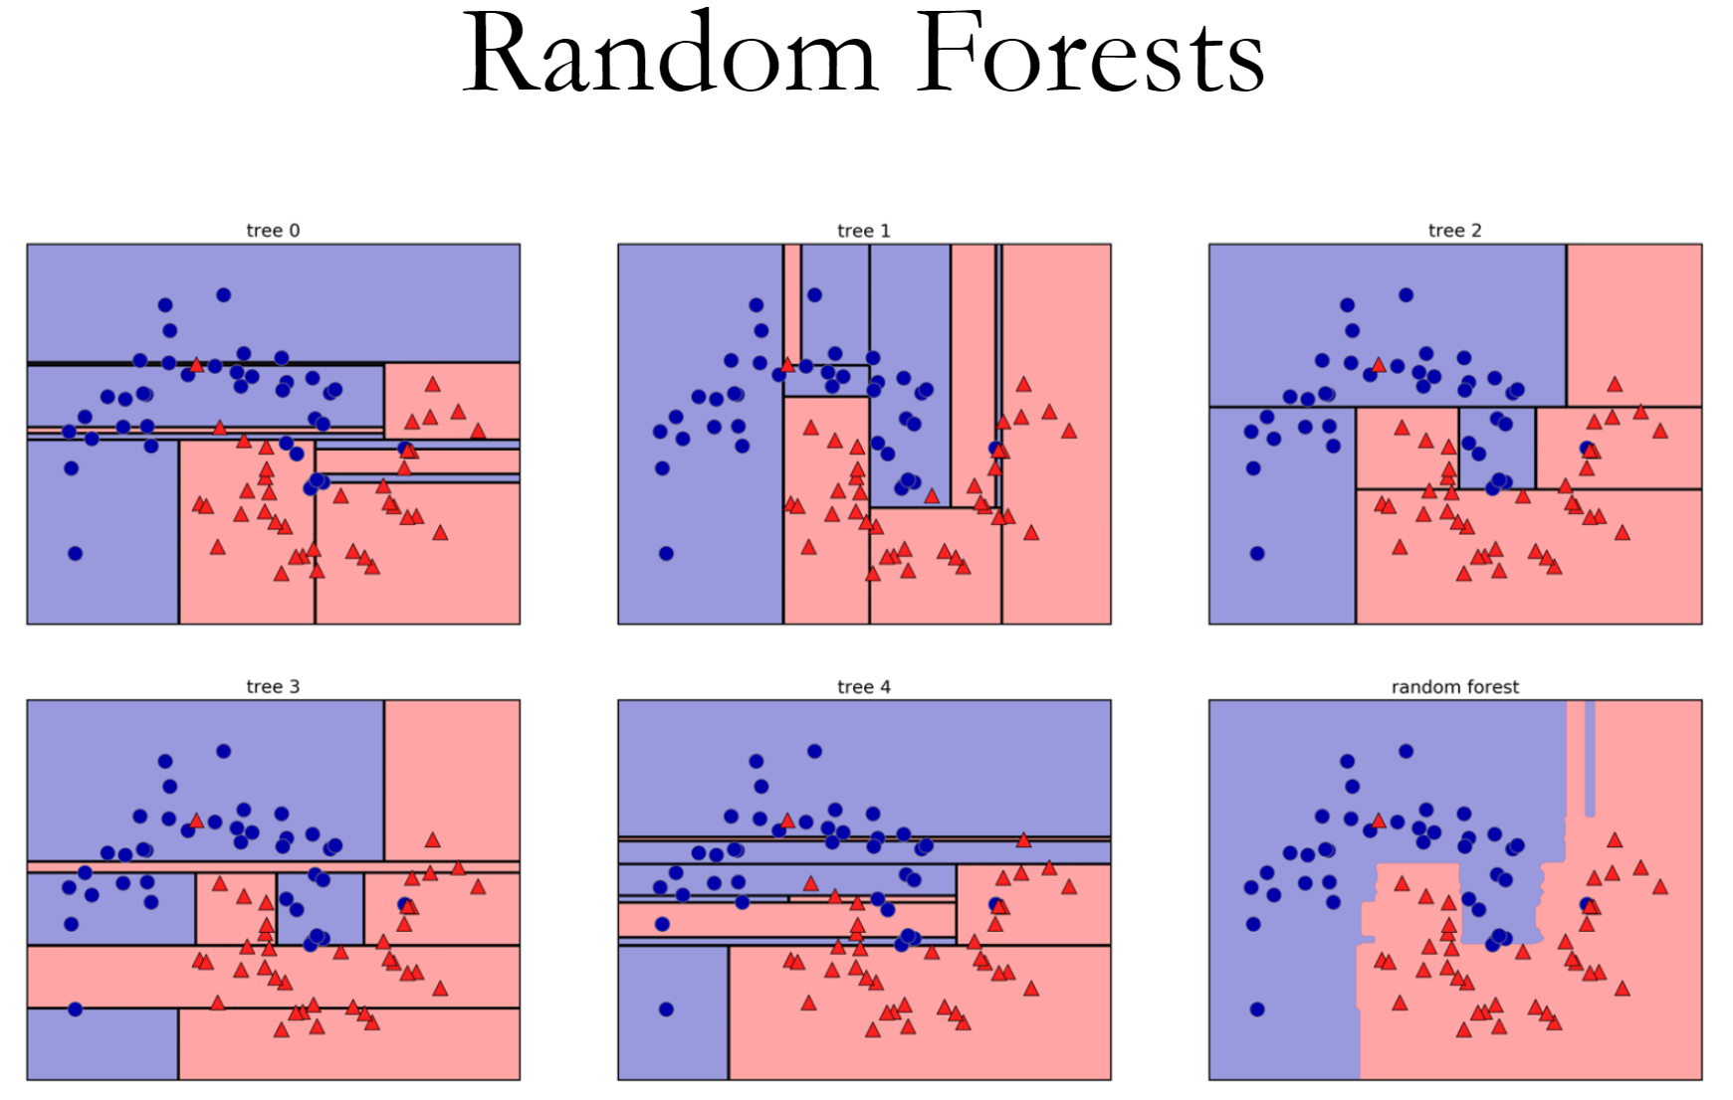

Slide 39
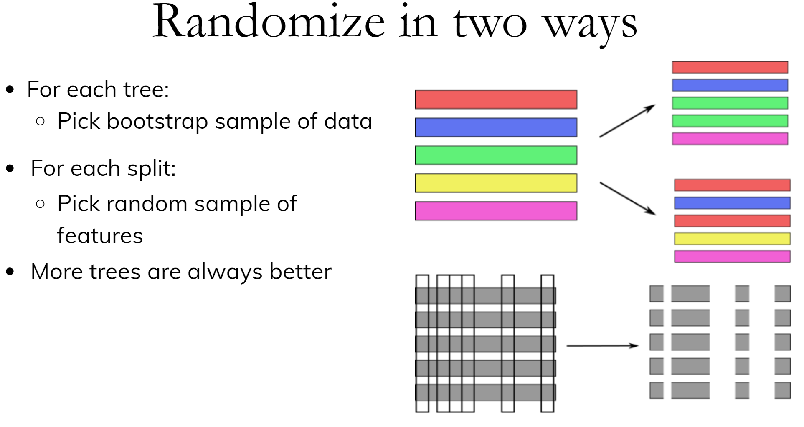

Slide 40
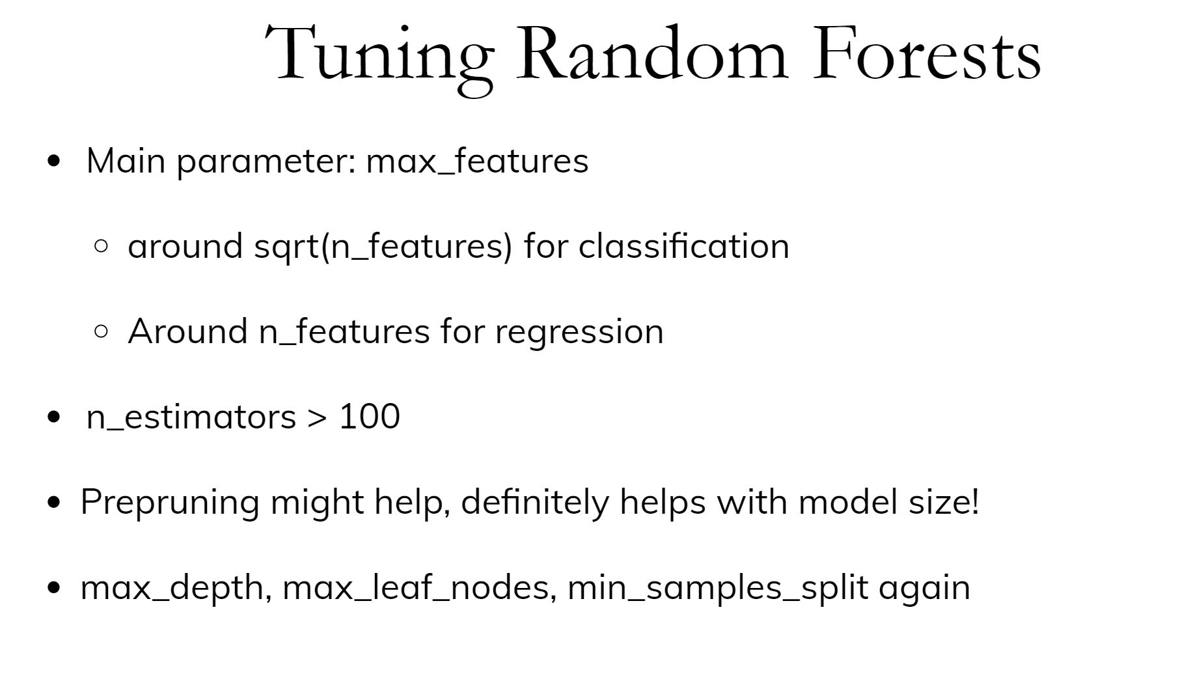

Slide 41
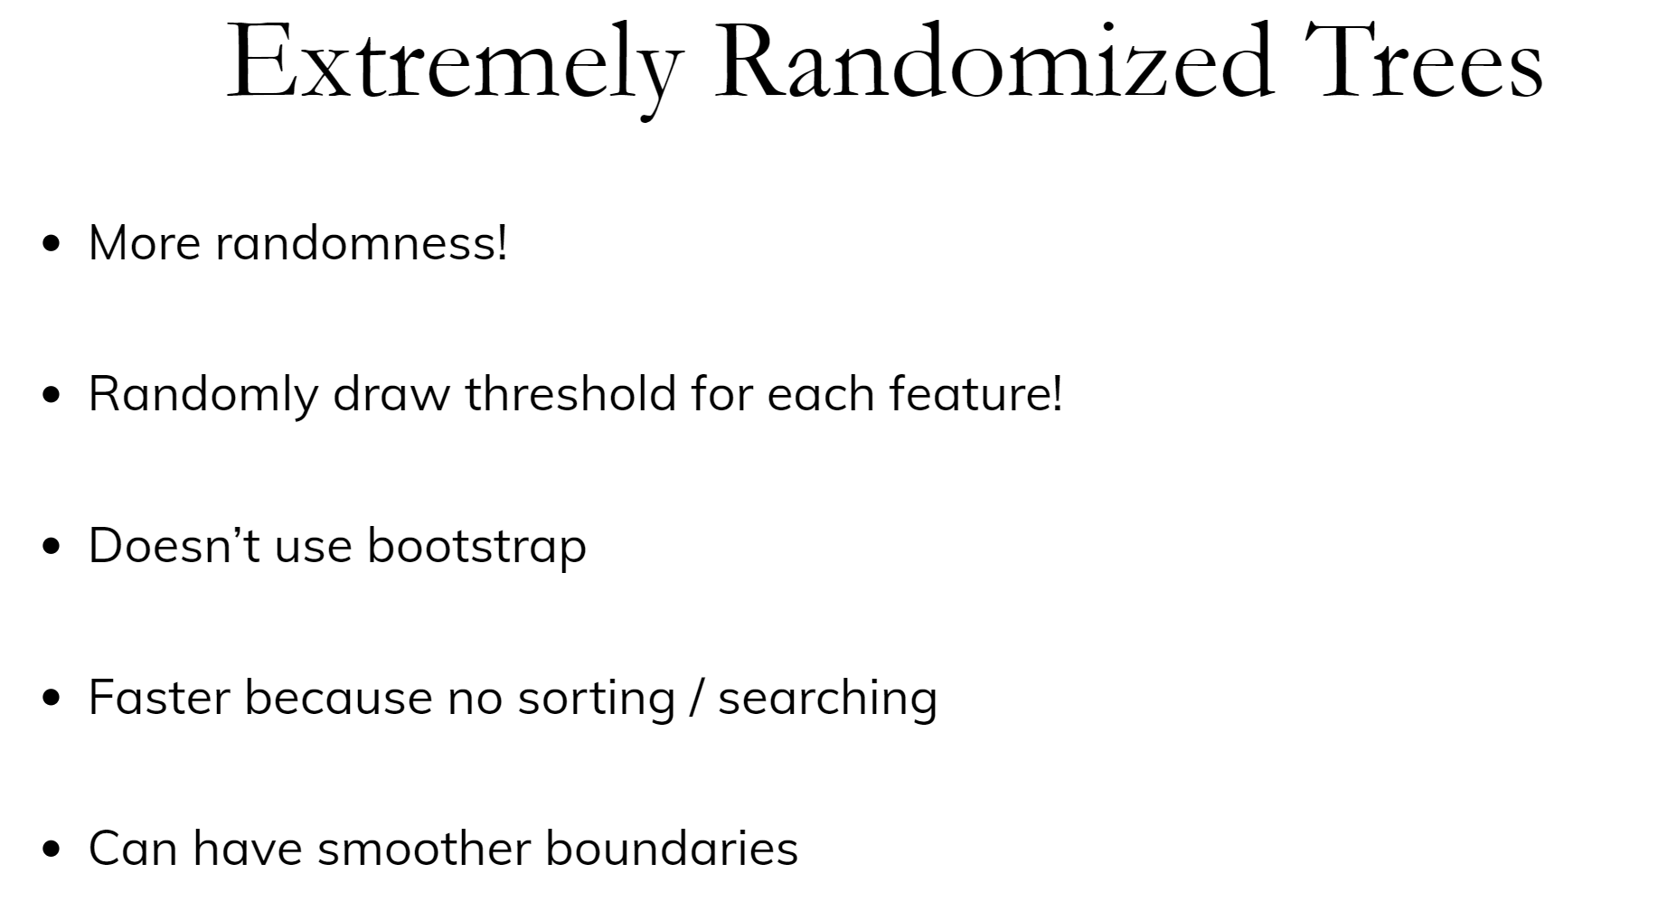

Slide 42
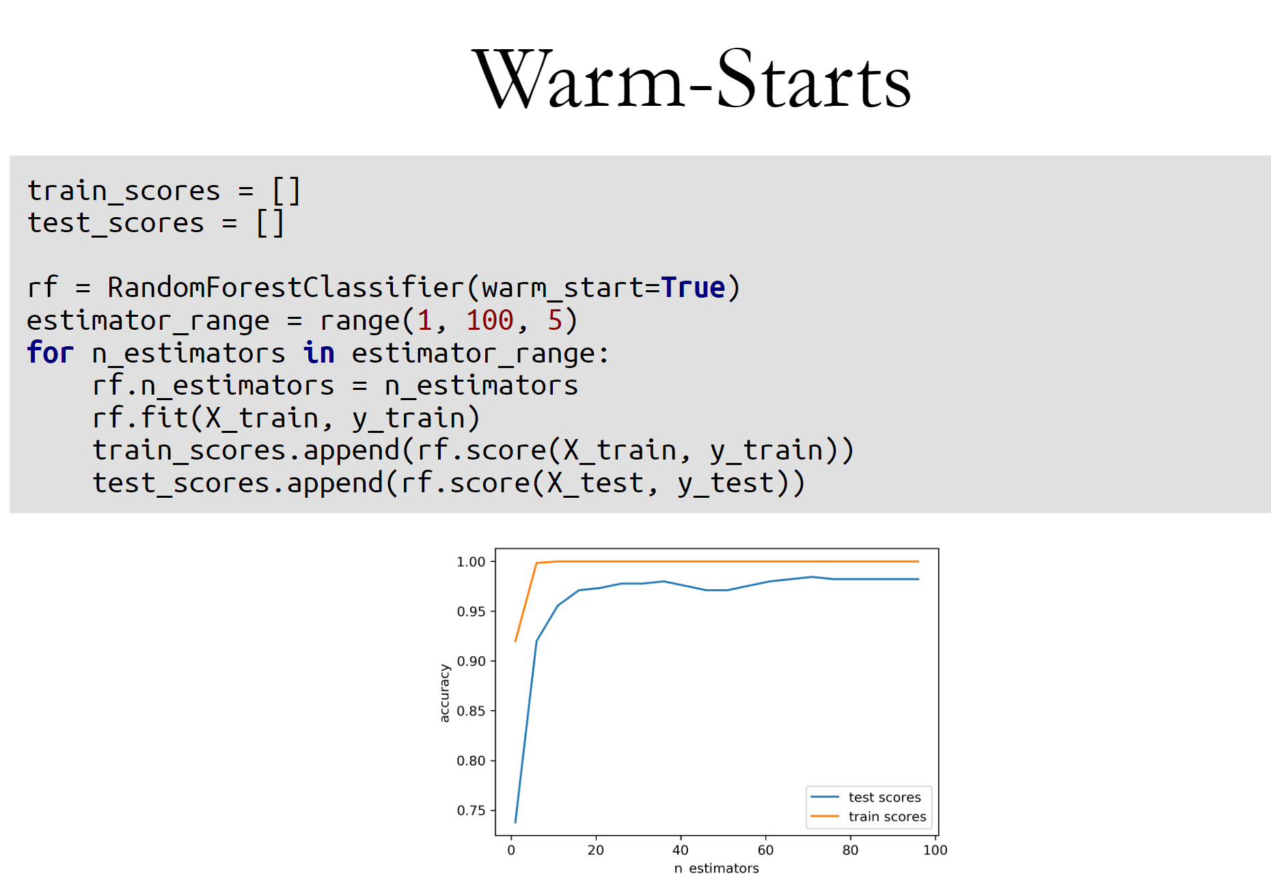

Slide 43
